Slide 1
FLOOD DETECTION SYSTEM
PUVIYARASAN R(201CE137)
HARI A(211CE503)

Slide 2
ABSTRACT
Environmental monitoring usingWireless sensor network (WSN) is one of the most challenging bustles handled by the research community.Hence it is decisive to employ the contemporary sensing and communication equipment to observe and identify flood incidences.Terrestrial wireless sensor networks are subject to extensive research and development. Numerous applications take advantage of low-cost, small-sized, easily configurable and scalable TWSN nodes to monitor, detect, and track various environmental phenomena and events. The recent advancement in electronics and sensor miniaturization and low-power technologies enabled TWSNs to extend their reach to underwater applications. The role of the designed Flood Monitoring and Evasion System based on WSN is to continuously monitor, detect and report the environment’s status to a control unit using relative water level, thrust and intensity of water as flood indicators, whose values are gathered by sensors in the sensor field. The flood monitoring and evasion system monitors and computethe status of floods and sends flood notification message to the base station of such zones for necessary action. The system is composed of three major modules which are the sensor module, observation module and the transponder module. The developed system is stout and gives well-timed alert of flood occurrences and controls the flood gate to avoid flood in coastal area.
Keywords—Wireless Sensor Networks (WSNs), Environmental Monitoring (EM), Tide, TWSN.

Slide 3
PROBLEM STATEMENT ADDRESSED
An IOT early flood detection and alert system using the Arduino is thus, a proposed solution to this problem. The system consists of various sensors which are temperature, humidity, water level, flow and ultrasonic sensors and also includes an Arduino controller, a Wi-Fi module, an LCD, an IoT remote server-based platform and an android application with constructed user friendly GUI relaying all the vital information involved in the picture in a visual format. This model set up the NODEMCU board near the dam and DHT sensor and ultrasonic sensor, float sensor are connected to it.DHT sensor gives the Humidity and Temperature in the air and Ultrasonic sensor gives the water level.

Slide 4
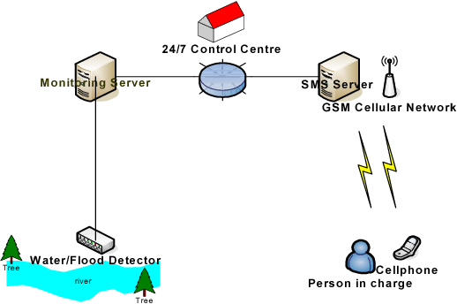
EXISTING SOLUTION

Slide 5
PROPOSED SOLUTION
An IOT early flood detection and alert system using the Arduino is thus, a proposed solution to this problem. The system consists of various sensors which are temperature, humidity, water level, flow and ultrasonic sensors and also includes an Arduino controller, a Wi-Fi module, an LCD, an IoT remote server-based platform and an android application with constructed user friendly GUI relaying all the vital information involved in the picture in a visual format. This model set up the NODEMCU board near the dam and DHT sensor and ultrasonic sensor, float sensor are connected to it.DHT sensor gives the Humidity and Temperature in the air and Ultrasonic sensor gives the water level. Based on this and some other parameters we may decide if the flood is going to occur or not. We connect them to the cloud from where we connect this to the mobile application and we can see the output in our application too.

Slide 6
An effective flood warning system should be based on the regular collection of local rainfall, stream level, and streamflow data. This can be done through routine monitoring, in which operating personnel make visits to stream gage and precipitation measuring sites, but a real-time monitoring system with telemetry can make data collection easier — and in many cases, more cost-effective — while allowing for the fastest possible response to a flood event. The NWS acknowledges that, even in areas where they provide flood warning coverage, a real-time, community-oriented flood warning system can reduce risks involved with flooding.
The NWS forecasts floods using complex mathematical models that predict how rivers and streams across the U.S. will respond to varying levels of rainfall and snowmelt. These models are based on records of stream stage and discharge, the calculations for which are outlined below. If you are interested in developing a responsive flood warning system without advanced forecasting capabilities, however, you can likely get by with a system based on Automated Local Evaluation in Real Time, or ALERT gages.

Slide 7
ALERT Gages
There are a wide variety of automated stream gages that can transmit stream level data via telemetry, but gages developed according to the NWS ALERT protocol are among the most common and will be the focus of this guide. However, it’s worth noting that many other gages designed to measure precipitation and water level operate under similar principles, and this guide may be applicable to certain aspects of other systems.
ALERT systems have the advantage of operating under a common standard of communications criteria, so although a wide array of manufacturers develop and produce ALERT hardware and software, most of those products are cross-compatible.
Data Processing
The software used to collect and process data from ALERT gages will vary based on the user’s needs and preferences. Many ALERT gage manufacturers offer their own proprietary software to view data remotely, whether in a graphical or text format. The most useful ALERT processing software will permit multiple users to access the data simultaneously, and for multiple gages to be monitored at once.
Information Dissemination
Automated flood warning systems may utilize radio, cellular, or satellite telemetry to communicate with a host computer or network, but ALERT systems specifically operate using radio frequencies. Because of this, ALERT systems can suffer from some of the same issues as any other radio transmission device, including interference from electrical noise and atmospheric conditions. Interference may also occur if several ALERT systems operating in a close vicinity transmit simultaneously. Satellite and cellular telemetry tends to avoid these problems, but still require some consideration to site selection in order to maximize transmission quality

Slide 8
PROJECT WORK PLAN
The Sensor Monitoring module receives data streams from the sensors installed in the dike. Raw sensor data is filtered by the AI Anomaly Detector that identifies abnormalities in dike behavior or sensor malfunctions. The Reliability Analysis module calculates the probability of dike failure in case of abnormally high water levels or an upcoming storm and extreme rainfalls. If the failure probability is high then the Breach Simulator predicts the dynamics of a possible dike failure, calculates water discharge through the breach and estimates the total time of the flood. After that, the Flood simulator models the inundation dynamics. For expert users, the Virtual Dike component is available. All these EWS modules are described in more detail in Sections 2-6. Information from all the modules is fed into the Decision Support System (DSS), some elements of which are shown in Fig. 2. The primary user-interface to this DSS system runs on the Microsoft Surface interactive graphics device (further called Surface for short). The Surface is a “multiǦtouch” system, which means that multiple people can collaboratively work with the applications, using their hands and fingers as input devices. The combination of multiple people interacting with the application at the same time makes the use of this device very intuitive and helpful for crisis situations –exactly what Early Warning Systems are designed for. The simulation modules and visualization components are integrated into the Common Information Space. They are accessed from the interactive graphical environment of the multi-touch table or through a web-based application.

Slide 9
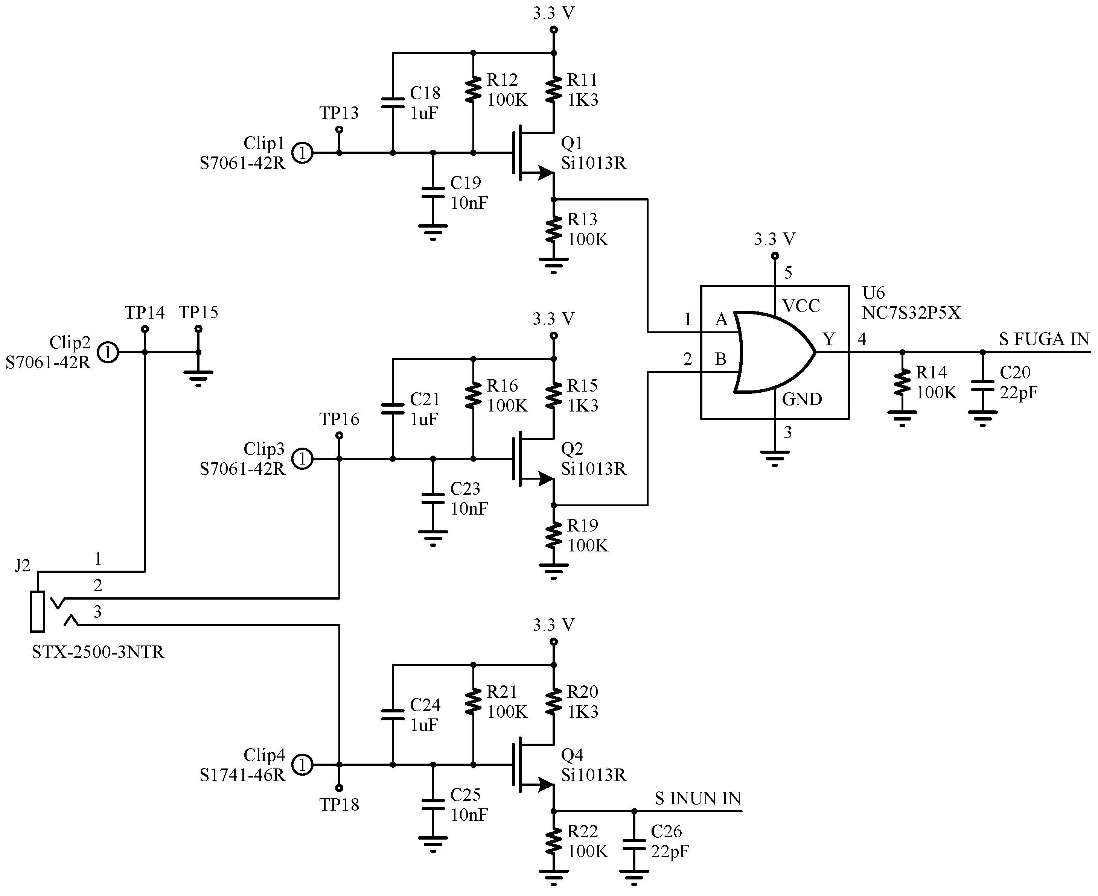
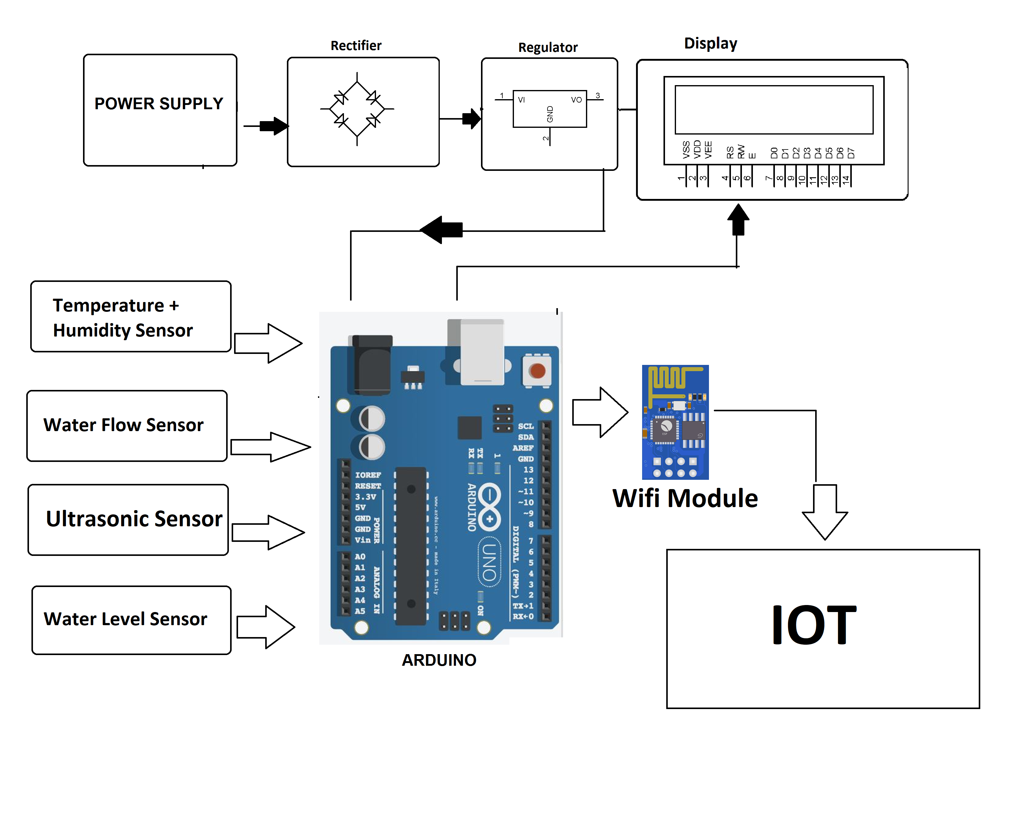
Block Diagram and Circuit Diagram

Slide 10
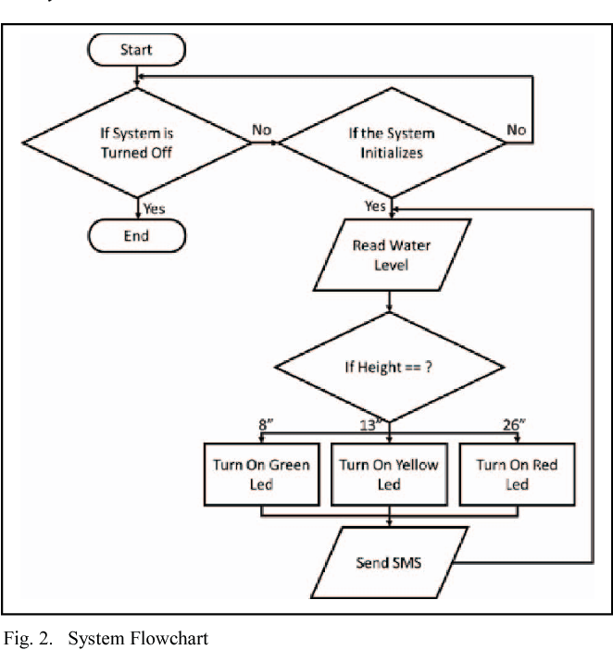
FLOW CHART

Slide 11
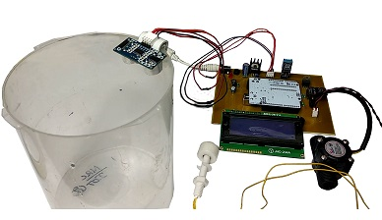
TECHNOLOGY STACK & USE CASE

Slide 12
PROTOTYPE & SAMPLE OUTPUT
#include
LiquidCrystal lcd(2,3,4,5,6,7);
float t = 0;
float dist = 0;
void setup()
{
lcd.begin(16,2);
pinMode(18,OUTPUT); //trigger
pin pinMode(19,INPUT);
//echo pin pinMode(20,OUTPUT); //buzzer lcd.setCursor(0,1);
lcd.print(" Water Level Detector");
delay(2000);
}
void loop() { lcd.clear();
digitalWrite(20,LOW);
digitalWrite(18,LOW);
delayMicroseconds(2);
digitalWrite(18,HIGH);
delayMicroseconds(10);
digitalWrite(18,LOW);
delayMicroseconds(2);
t=pulseIn(19,HIGH);
dist=t*340/20000;
lcd.clear();
lcd.setCursor(0,1); l
cd.print("Distance : ");
lcd.print(dist/100);
lcd.print(" m");
delay(1000);
if(dist<40)
{
digitalWrite(20,HIGH);
lcd.clear();
lcd.setCursor(0,1);
lcd.print("Water level is rising. Kindly evacuate");
delay(2000); }
else
{
digitalWrite(20,LOW);
delay(2000);
}
}

Slide 13
ANALYSIS OF RESULTS & DISCUSSIONS
The objective of this project is to monitor the flood situation & send alert in case of danger in the form of text message. The main objective of this project is to detect rising water level in a river at a reasonable distance from the rail track/ roadways and intimate that to the respective authorities through SMS, to take appropriate action.Floods lead to a vast loss of life and property in many countries. But in developing countries the lack of proper technology leads to more loss of life and property due to flood. This is due to lack of flood detection systems.
Our project solves problem by implementing an early flood detection mechanism.In this project we will connect electrodes at different levels. Electrodes will be interfaced with µC through comparator. GSM modem containing a SIM card will be connected to µC. At the other end mobile will be used. Mobile number of user will be stored in µC coding. Whenever water level reaches to electrodes. SMS will be sent to mobile.By keeping water out, flood control structures lessen harm to physical infrastructure and help to ensure continuation of communities' economic and social activity. But flood control structures do not completely eliminate risk. Flooding may occur if the design water levels are exceeded.Flood warning is the provision of advance warning of conditions that are likely to cause flooding to property and a potential risk to life. The main purpose of flood warning is to save life by allowing people, support and emergency services time to prepare for flooding. Some people may not be able to access the warnings. Flash floods may happen too quickly for a warning to be effective. They do not stop land from flooding - they just warn people that a flood is likely.

Slide 14
REFERENCE
1.M. Castillo-Effen, D. H. Quintela, R. Jordan, W. Westhoff, and W. Moreno, “Wireless sensor networks for ﬂash-ﬂood alerting,” in Proceedings of the Fifth IEEE International Caracas Conference on Devices, Circuits and Systems. IEEE, Nov 2004, pp. 142–146
2. Alexei V. Kouraeva,b,*, Elena A. Zakharovab, Olivier Samainc, Nelly M. Mognarda, Anny Cazenavea: Ob’ river discharge from TOPEX/Poseidon satellite altimetry (1992–2002), Remote Sensing of Environment 93 (2004) 238– 245

